Slide 1
Analysis Template & 2D Visualization
21-July 2011

Slide 2
Proposed Analysis Template
The “analysis template” is a common interface for writing behaviors
Five properties (can be expanded):
Name is used to identify behavior
Description, units, and bounds provide human-readable details
Value is dynamically assigned after evaluation (allows caching)
Three methods (can be expanded):
Constructor (initializes behavior)
Evaluate function to assign and return value (sealed: cannot be edited – guarantees value is always updated)
EvaluateImpl function (abstract and protected: must be custom-coded but can only be called by Evaluate)
Behavior
+ name
+ description
+ units
+ bounds
+ value
+ Behavior(name, description, units, bounds)
+ sealed Evaluate()
# EvaluateImpl()

Slide 3
Examples of Usage
Two examples from the /_example directory:
NumberResidentsCity.m
NumberResidentsCell.m
(Can be used after running mainTutorial_complete.m)
Two examples from the /_tutorial directory:
QuickestPath.m
ShortestPath.m
(Can be used after running mainExample.m)

Slide 4
Example 1: Number Residents (City-wide)
Calls EvaluateImpl
NumberResidentsCity
% example command-line usage
b = NumberResidentsCity();
b.value; % []: not yet evaluated
pop = b.Evaluate();
b.value; % stored copy of evaluation
+ NumberResidentsCity()
# EvaluateImpl(cell)
function val = EvaluateImpl(obj)
val = 0;
for s=1:length(CityNet.instance().city.systems)
for i=1:length(CityNet.instance().city.systems(s).nodes)
node = systems(s).nodes(i);
resDen = node.GetNodeTypeAttributeValue('residentDensity');
if ~isempty(resDen)
val = val + node.cell.GetArea()*resDen;
end
end
end
end

Slide 5
Example 2: Number Residents (Cell Specific)
Assigns extra input
NumberResidentsCell
+ cell
% example command-line usage
b = NumberResidentsCell();
b.cell = cityNet.city.cells(53);
b.value; % []: not yet evaluated
pop = b.Evaluate();
b.value; % stored copy of evaluation
Extra Input
+ NumberResidentsCell()
# EvaluateImpl()
function val = EvaluateImpl(obj)
val = 0;
for s=1:length(CityNet.instance().city.systems)
for i=1:length(CityNet.instance().city.systems(s).nodes)
node = systems(s).nodes(i);
if node.cell==obj.cell
resDen = node.GetNodeTypeAttributeValue('residentDensity');
if ~isempty(resDen)
val = val + node.cell.GetArea()*resDen;
end
end
end
end
end
Extra Check using Input

Slide 6
Example 3: Quickest Path
Assigns extra inputs
QuickestPath
Extra Inputs
% example command-line usage
b = QuickestPath(cityNet.city.systems(3), ... [0.25,0.0,1],[1.3,2.1,1]);
time=b.Evaluate();
b.value; % stored copy of evaluation
b.path; % stored copy of path
+ system
+ origin
+ destination
+ path
Extra Output
+ QuickestPath(system, origin, destination)
# EvaluateImpl(system)
Access extra output
function val = EvaluateImpl(obj)
lengths = zeros(length(obj.system.edges),1);
for i=1:length(obj.system.edges)
speed = obj.system.edges(i).GetEdgeTypeAttributeValue('speed');
if ~isempty(speed) && speed > 0
lengths(i) = obj.system.edges(i).GetEuclideanLength()/speed;
else
lengths(i) = inf;
end
end
% call to custom implementation of Djikstra's algorithm
solution = Djikstra.solve(obj.system.nodes, obj.system.edges, ...
lengths, obj.origin, obj.destination);
obj.path = solution.path;
val = solution.distance;
end

Slide 7
Challenges for Analysis Template
Agreement on common attribute names
Node/edge properties can only be accessed by attribute name, thus there must be some agreement here
Option 1: Can adopt common attribute names
Option 2: Can rely on system-specific behaviors, e.g. TransportationSystemEnergyConsumption
Requires some iteration and testing to explore
Circular dependencies between behaviors
Example: Energy system needs transportation system’s energy consumption behavior for its energy production, transportation system needs energy system’s energy production behavior for energy consumption
Caching and iteration until convergence may be required
GUI / user friendly interface ?

Slide 8
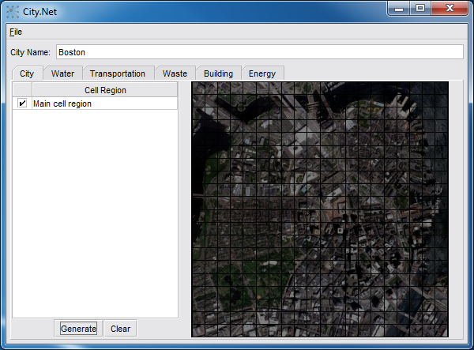
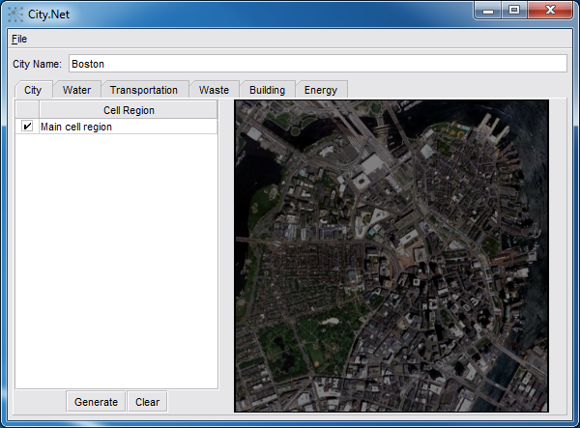
2D Visualization Prototype – “City Viz”
Display Cell Regions and Cells
Toggle Cell Region Visibility
Generate/Clear Cells

Slide 9
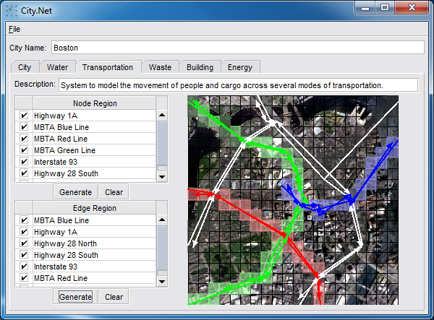
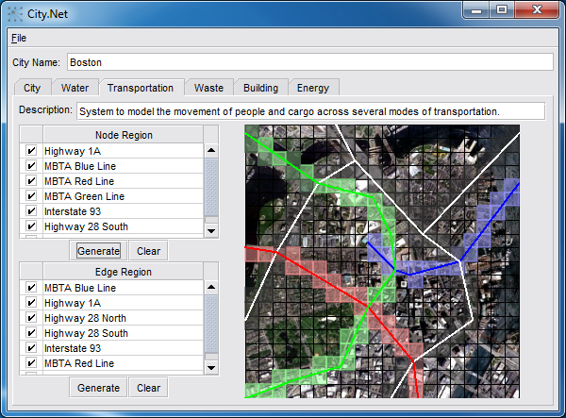
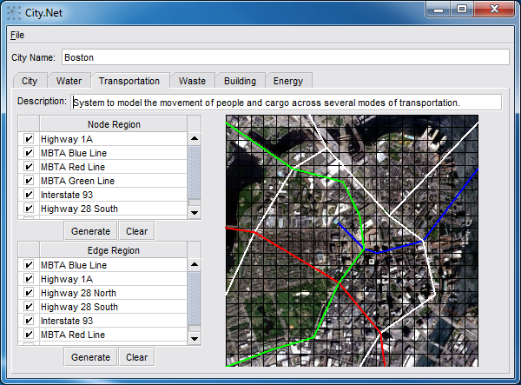
2D Visualization Prototype – “System Viz”
Display Node Regions, Edge Regions, Cells, Nodes, and Edges
Toggle Node Region Visibility
Generate/Clear Nodes
Toggle Edge Region Visibility
Generate/Clear Edges

Slide 10
2D Visualization Notes
Proof-of-concept of Java implementation
No problems with geometry operations or 2D graphics
Visualization gets cluttered with too much information
Could add opacity slider for each object classification (node/edge/cell region, node/edge/cell)
Layers are not displayed
Could filter display by layer (e.g. tabs, checkboxes, etc.)
No existing way to visualize inter-layer edges
Requires 3D visualization

